Slide 1
CSE 165/ENGR 140 Intro to Object Orient Program
Lecture 4 – C in C++

Slide 2
Announcement
Lab #1
9/9
Reading assignment
Ch. 3, Vol. I

Slide 3
(Review) Execution Control: switch
char expression;
switch (expression)
{
case ‘I’ :
<statement1>
break;
case ‘R’ :
<statement2>
break;
default :
<statement3>
break;
}
char expression;
if (expression == ‘I’)
<statement1>
else if (expression == ‘R’)
<statement2>
else
<statement3>

Slide 4
(Review) Flowchart of a switch Statement
…
Expression
Case 1
Code block 1
break
Case 2
Code block 2
break
Case 3
Code block 3
break
Default
Default code
break
End

Slide 5
(Review) Rules Applied to a switch Statement
The expression must have an integral or enumerated type, or be of a class type in which the class has a single conversion function to an integral or enumerated type
A program can have any number of case statements within a switch. Each case is followed by the value to be compared to and a colon
The constant expression for a case must be the same data type as the variable in the switch, and it must be a constant or a literal

Slide 6
(Review) Rules Applied to a Switch Statement
When a break statement is reached, the switch terminates, and the flow of control jumps to the next line following the switch statement
Not every case needs to contain a break. If no break appears, the flow of control will fall through to subsequent cases until a break is reached
A switch statement can have an optional default case, which must appear at the end of the switch. The default case can be used for performing a task when none of the cases is true. No break is needed in the default case

Slide 7
Data types: scope
Variables can be defined anywhere
Scope of a variable
global
Can be used throughout the program
local
Occurs within a scope (local to a function)
global but of limited scope: use static keyword
Limited to a file
More on static in future lectures

Slide 8
Data types: primitive types
Types
char, int, float, double
Modifiers
unsigned, signed, short, long
Type limits
Data type size varies depending on systems (16/32/64-bit CPU architecture)
Use sizeof operator to determine size of each data type
Specified in C header files (limits.h and float.h) and C++ header files <climits> and <cfloat>

Slide 9
Data types: bool
bool was introduced in C++
Only contains true (1) or false (0)
Conditional expressions always produce boolean types
Automatic conversions:
int -> bool:
Zero -> false
Non-zero -> true
pointer -> bool:
Null pointer -> false
Non-null pointer -> true

Slide 10
Use of bool
Examples:
bool is_small = a<=10;
cout << (is_small? "small" : "large");
bool in_unit_interval = (n>=0.0 && a<=1.0)? true:false;
bool initialized = false;
if(!initilized)
init();
bool newcmd = true;
while(newcmd)
{
newcmd = enter_new_command();
}

Slide 11
Data types: constants
Modifier const
Can be of any type and in any scope
Always has to be initialized
const int x = 10;
Alternative: preprocessor macro, e.g., # define PI 3.14
Use const in C++ whenever possible
More Complex Macros
# define GS_ABS(x) ((x)>0? (x):-(x))
# define GS_MIN(a,b) ((a)<(b)? (a):(b))
# define GS_MIN3(a,b,c) ((a)<(b)? ((a)<(c)?(a):(c)):((b)<(c)?(b):(c)))

Slide 12
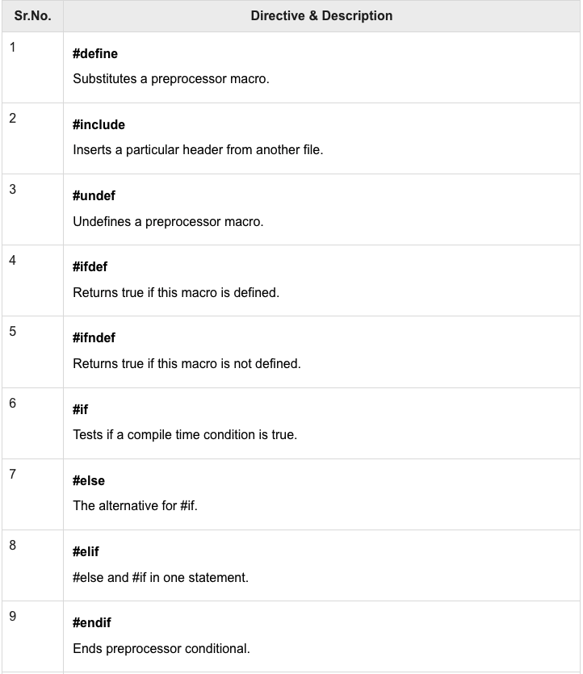
Preprocessor
A text substitution tool and instructs the compiler to do required pre-processing before the actual compilation
A preprocessor directive begins with #

Slide 13
Data types: pointers and references
A pointer is a variable holding memory address of another variable
Every variable, object, or function has an address
Reference is introduced in C++ as a new way to work with the address of a variable
An alias (i.e., another name) for an already existing variable
Stores the address of a variable (like a pointer)
Avoids the heavy syntax needed to work with pointers but allows the same kind of functionality
Contrary to pointers, references are always valid
Pointers can be “null” or be of void type (e.g., void*), reference cannot

Slide 14
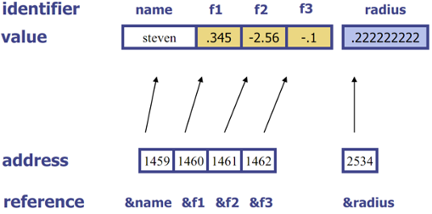
Memory: address and value

Slide 15
Reference and De-reference
type& reference declaration
type* pointer declaration
& reference operator: "address of"
* dereference operator: "value pointed by"
Equivalent to:
&: Address of John is 52 Main Street
*: Value at 52 Main Street is John

Slide 16
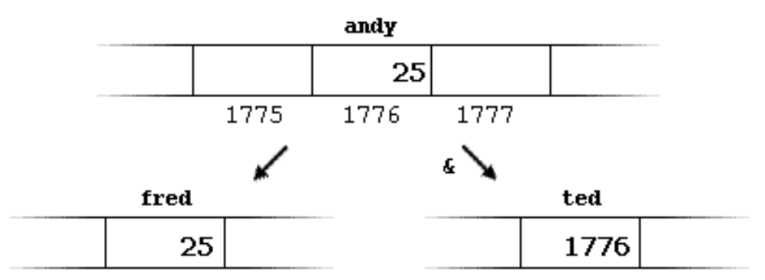
Reference operator: &
int andy = 25; // andy contains 25
int fred = andy; // fred contains the value of andy (25)
int ted = &andy; // ted contains the address of andy (1776)
Memory address:

Slide 17
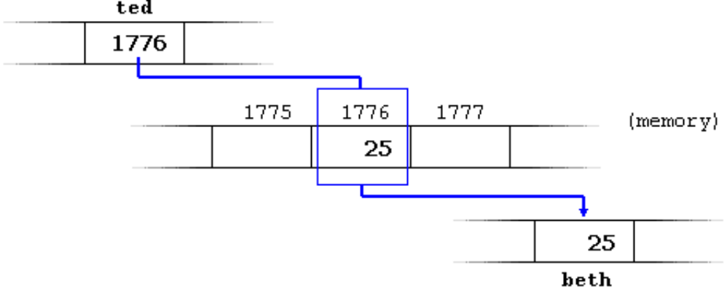
De-reference operator: *
int andy = 25; // andy contains 25
int fred = andy; // fred contains the value of andy (25)
int ted = &andy; // ted contains the address of andy (1776)
int beth = *ted; // beth equals to the value pointed by ted (25)

Slide 18
Variables of pointer type
Declaration:
type * name
type* name
type *name
Examples:
int * p_int; // p_int is a pointer of type int
char * p_char; // p_char is a pointer of type char
float * p_float; // p_float is a pointer of type float
…

Slide 19
Pointer initialization
A pointer is initialized
When it’s defined
int number;
int* p_number = &number;
Or after it’s defined
int number;
int* p_number;
p_number = &number;

Slide 20
Variables and pointers
Define:
type * name1, * name2; // defines 2 pointers type*
type * name1, name2; // defines 1 pointer type and 1 variable type
Example:
int *p_i, i, j;
i = 10;
p_i = &i;
p_i = &j;

Slide 21
Reference example
//: C03:YourPets2.cpp
#include <iostream>
using namespace std;
int dog, cat, bird, fish;
void f(int pet) {
cout << "pet id number: " << pet << endl;
}
int main() {
cout << "f(): " << (long)&f << endl;
cout << "dog: " << (long)&dog << endl;
cout << "cat: " << (long)&cat << endl;
cout << "bird: " << (long)&bird << endl;
cout << "fish: " << (long)&fish << endl;
}
Result:
f(): 4198736
dog: 4323632
cat: 4323636
bird: 4323640
fish: 4323644

Slide 22
Another reference example
//: C03:PassReference.cpp
#include <iostream>
using namespace std;
void f ( int& r ) { // Accepting reference
cout << "r = " << r << endl;
cout << "&r = " << &r << endl;
r = 5;
cout << "r = " << r << endl;
}
int main() {
int x = 47;
cout << "x = " << x << endl;
cout << "&x = " << &x << endl;
f(x); // Looks like pass-by-value, but is actually pass by reference
cout << "x = " << x << endl;
}
Result:
x = 47
&x = 0065FE00
r = 47
&r = 0065FE00
r = 5
x = 5

Slide 23
Types: operators
Mathematical operators:
addition (+), subtraction (-), division (/), multiplication (*)
integer division truncates the result (if it doesn’t round)
modulus (%) produces the remainder of an integer division
cannot be used with floating-point numbers
Assignment operators: +=, -=, *=, /=, etc.
Logical operators
and (&&), or (||) produce true or false
Relational operators
Establish a relationship between the values of the operands.
Produce true if the relationship is true, and false if the relationship is false.
E.g., <, >, <=, >=, ==, !=

Slide 24
Types: operators
Bitwise operators
bitwise and (&)
1 if both input bits are 1; otherwise 0
bitwise or (|)
1 if either input bits are 1; 0 only if both are 0
bitwise exclusive or, or xor (^)
1 if an input bit is one, but not both; otherwise 0
bitwise not (~)
unary operator that inverts the input bit
Shift operators
left-shift operator (<<) and right-shift operator (>>)
Also valid: <<= and >>=
One bit is always lost in a shift operation
Ternary operator “? :” (syntax: expression 1? expression 2 : expression 3)
If expression 1 evaluates to true, then expression 2 is evaluated
If expression 1 evaluates to false, then expression 3 is evaluated

Slide 25
Types: casting
Types can be converted by C-like type-casts in parenthesis.
In C++ we should use:
static_cast: simple casts for type conversion
const_cast: removes const
reinterpret_cast: converts any pointer type to any other pointer type, even of unrelated classes
dynamic_cast: type-safe cast with run-time checking, and can be used only with pointers and references to objects (will discuss in later lectures)
//: C03:FunctionCallCast.cpp
int main() {
float a = float(200);
// This is equivalent to:
float b = (float)200;
}

Slide 26
static_cast
Used for all conversions that are well-defined, including safe and less-safe conversions that the compiler would allow you to do without a cast
The types of conversions covered by static_cast include
typical castless conversions
narrowing (information-losing) conversions,
forcing a conversion from a void*

Slide 27
static_cast: castless conversions
//: C03:static_cast.cpp
int main() {
int i = 0x7fff; // Max pos value = 32767
float f;
// 1a) Typical castless conversions:
f = i; // may generate a warning
// 1b) C-style type cast:
f = (float)i; // no warning
// 1c) C++ way:
f = static_cast<float>(i);

Slide 28
static_cast: narrowing conversions
//: C03:static_cast.cpp (continuation)
int i; // Max pos value = 32767
float f = 3.1415926;
// 2a) Automatic narrowing conversions:
i = f; // May lose digits (will generate a warning)
// 2b) Says "I know," eliminates warnings:
i = (int)(f); // C style
// 2c) C++ way:
i = static_cast<int>(f); // C++ style

Slide 29
static_cast: forcing a conversion from void*
//: C03:static_cast.cpp (continuation)
int i = 0x7fff;
// 3a) Forcing a conversion from void* :
void* vp = &i;
// 3b) Old way produces a “dangerous” conversion:
float* fp = (float*)vp;
// 3c) The new way is equally dangerous:
fp = static_cast<float*>(vp);
// etc
}

Slide 30
const_cast
Used for conversions from const to nonconst
//: C03:const_cast.cpp
int main() {
//1) const values should not be modified:
const int i = 0;
//2) But we can get a pointer to them and later modify them…:
j = const_cast<int*>(&i); // Preferred
*j = 1;
}

Slide 31
reinterpret_cast
Converts any pointer type to any other pointer type, even of unrelated classes
The operation result is a simple binary copy of the value from one pointer to another
Not check if the pointer type and data pointed to by the pointer is same or not
Do not use it unless required!

Slide 32
reinterpret_cast
//: C03:reinterpret_cast.cpp
#include <iostream>
using namespace std;
const int sz = 100;
struct X { int a[sz]; };
void print(X* x) {
for ( int i = 0; i < sz; i++) cout << x->a[i] << ' ';
cout << endl << "--------------------" << endl;
}
int main() {
X x;
print(&x);
int* xp = reinterpret_cast<int*>(&x); // Cast to integer
for ( int* i = xp; i < xp + sz; i++ )
*i = 0;
// Can't use xp as an X* unless you cast it back:
print(reinterpret_cast<X*>(xp));
}
A reinterpret_cast<> can only be justified in rare situations. When you use a reinterpret_cast<> you tell the compiler that you need an unusual type of casting and that you know what you are doing.

Slide 33
Exercises
1. Which of the following is FALSE about references in C++?
A. References cannot be NULL
B. A reference must be initialized when declared
C. References cannot refer to constant value
✅

Slide 34
Exercises
2. The output of the following C++ program?
#include<iostream>
using namespace std;
int &fun()
{
int x = 10;
return x;
}
int main()
{
cout << fun();
return 0;
}
A. May cause runtime error
B. May cause compiler error
C. Always works fine
D. 0
✅
Ans: Since we return the reference to a local variable, the memory location becomes invalid after function call is over. Hence it may result in segmentation fault runtime error.

Slide 35
Exercises
3. The output of the following C++ program?
#include<iostream>
using namespace std;
int main()
{
int x = 10;
int& ref = x;
ref = 20;
cout << "x = " << x << endl ;
x = 30;
cout << "ref = " << ref << endl;
return 0;
}
x = 20 ref = 30
x = 20 ref = 20
x = 10 ref = 30
x = 30 ref = 30
✅
Ans: ref is an alias of x, so if we change either of them, we can see the change in other as well.

